Slide 1
Trends in the 2006 Pike’s Peek 10K Race
Ashley Mason

Slide 2
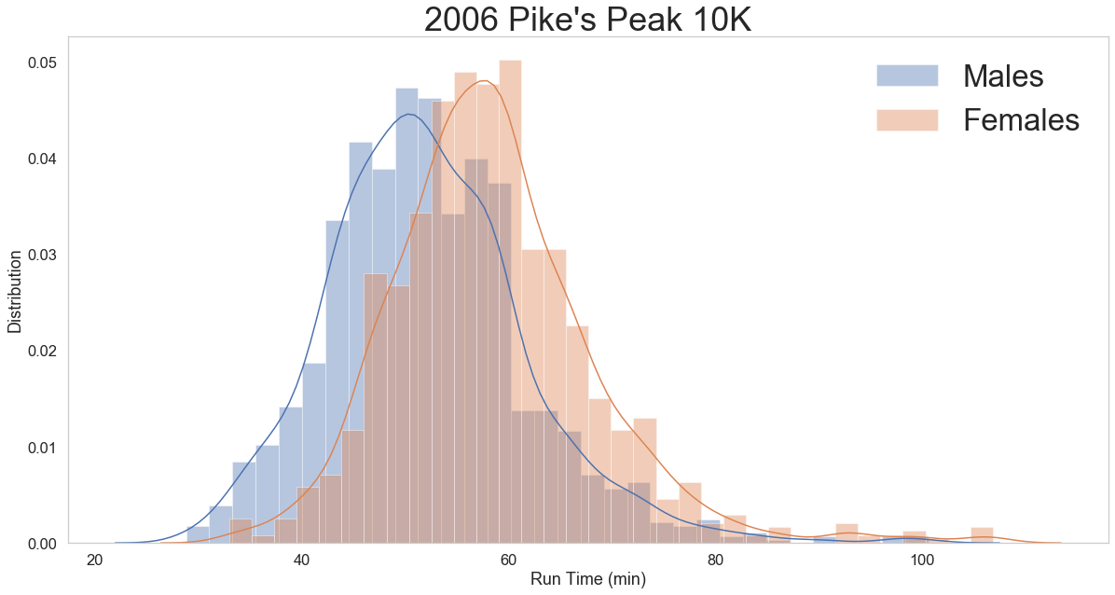
Men Vs. Women
 | Males | Females
Mean (min.) | 52.12 | 58.45
Median (min.) | 51.37 | 57.82
Mode (min.) | 35 | 48
Range (min.) | 71.85 | 73.85
The men's stats are generally lower than that of the women's. Placing them at slightly faster overall.

Slide 3
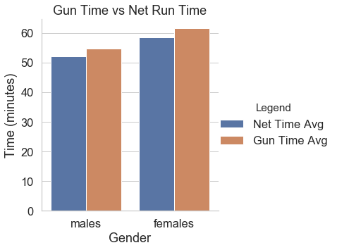
Gun Vs. Net Running Time Cont.
The gun and net running times are close. Women, who tend to be slower, have a proportional difference between their gun and net time.

Slide 4
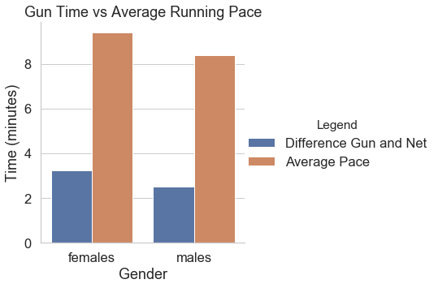
Gun Vs. Net Running Time
The difference between the gun and net running times seems to have the same trend as the pace. Which makes sense because a slower pace will take longer to get across the start line.

Slide 5
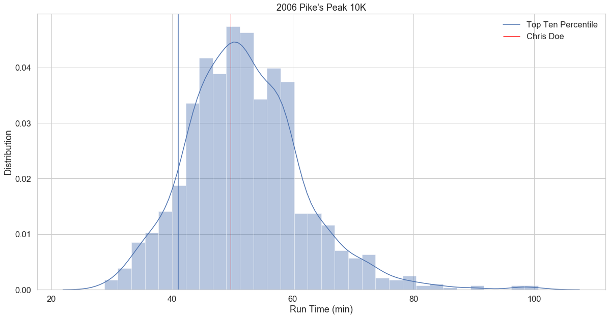
Where is Chris Doe?
Chris Doe is 8.72 minutes slower than the top ten percentile. That puts him with the majority of the other runners.
Chris: 49.72 min
41.0 min

Slide 6
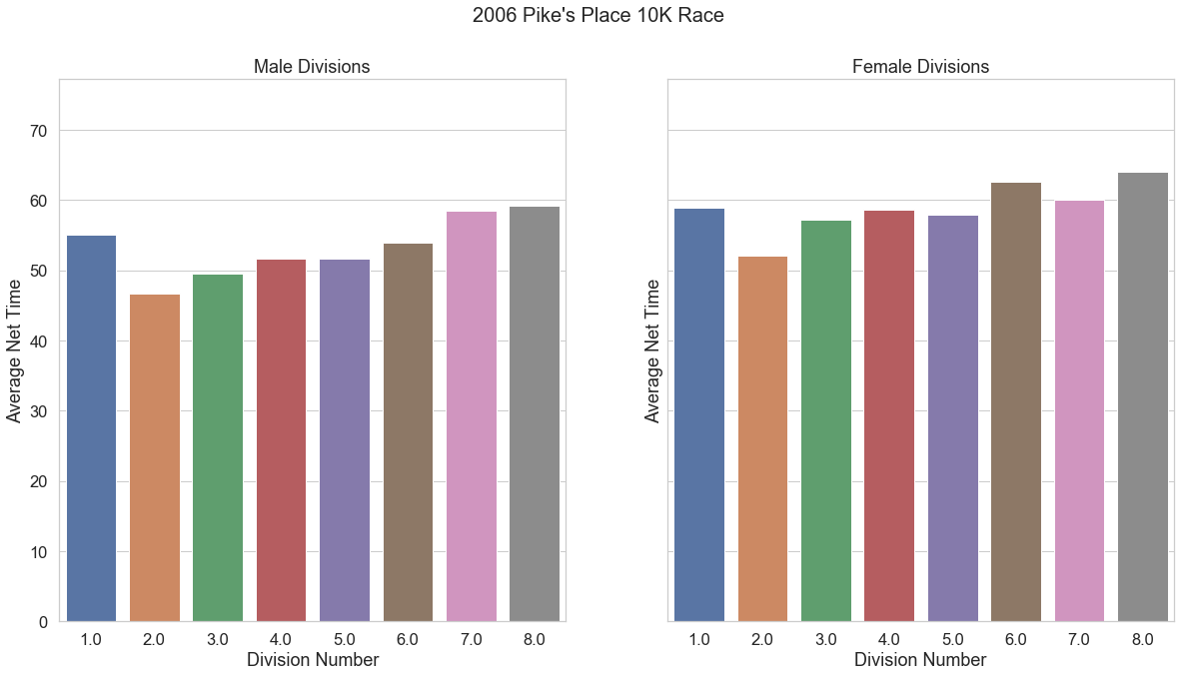
How did each division* do?
The data from the divisions show an interesting trend.
The second division (kids 15 to 19) are the fastest groups and as people age they tend to be slower.
Overall, males tend to be faster than females but both genders show a similar trend.
* The two youngest age groups are 0-14 and 15-19; the remaining age groups are separated by 10 year increments (e.g. 20-29, 30-39, etc.)

Slide 7
Acknowledgments
The data presented in this presentation was provided by Deloitte as a mission analytics data exercise.
Thank you!

